Slide 1
Asynchronous Programming
Advanced Unity

Slide 2
Content
Asynchronous programming.
Asynchrony vs Multithreading.
Race conditions.
Coroutines.
Coroutines vs Update.
Async.
Coroutines vs Async.
UniTask.

Slide 3
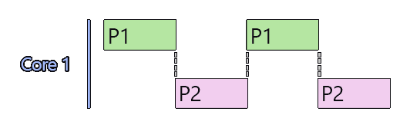
Asynchronous programming
It improves system efficiency, allowing multiple tasks to be performed concurrently (one of them starts between the start and end of the other).
Solves blocking and waiting problems in the main flow of the program.
It deals with how we organize tasks in an individual workflow.

Slide 4
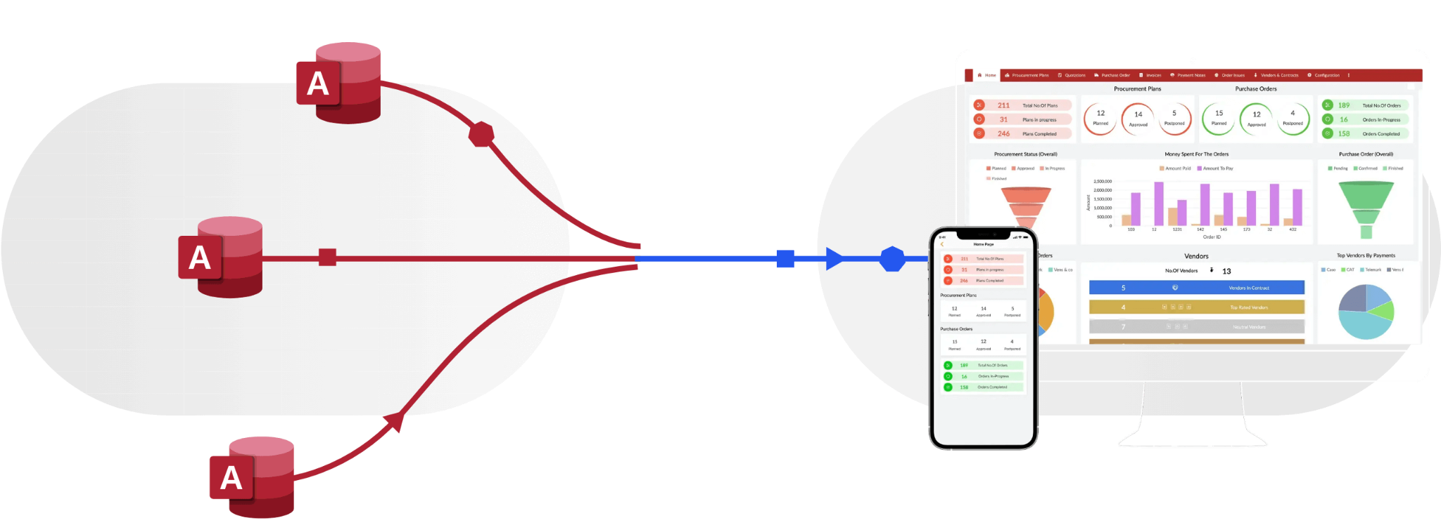
Asynchronous programming: Uses.
For tasks that involve a possible delay or wait such as file access, network use, or database queries.

Slide 5

Asynchronous programming: Uses.
Delay an action. Ex: Rate of fire.

Slide 6

Asynchronous programming: Uses.
Actions that need to be paused and resumed. The: Spawn from enemy streaks.

Slide 7
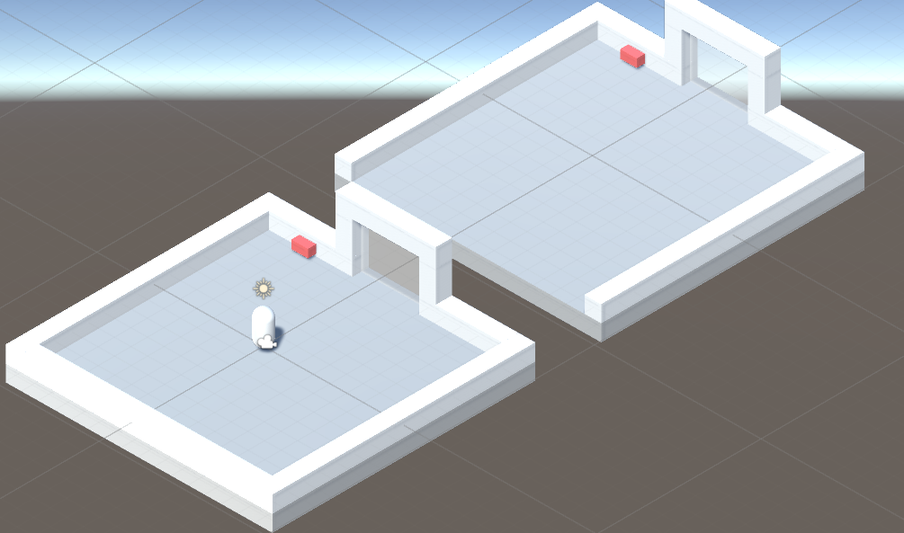
Asynchronous programming: Uses.
Actions that require several frames to complete. (Animations, transitions, smooth movements).

Slide 8
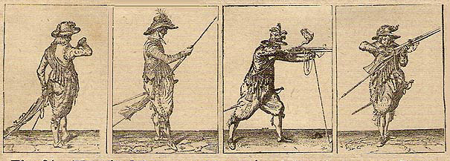
Asynchronous programming: Uses.
Sequence of actions.

Slide 9

Asynchronous programming vs Multithreading.
Asynchronous programming runs on the main thread or in the case of Multithreading each thread can be scheduled asynchronously.
In Multithreading we have several execution threads in which tasks can be executed in parallel.
Multithreading is about workers, the asynchrony of tasks.

Slide 10
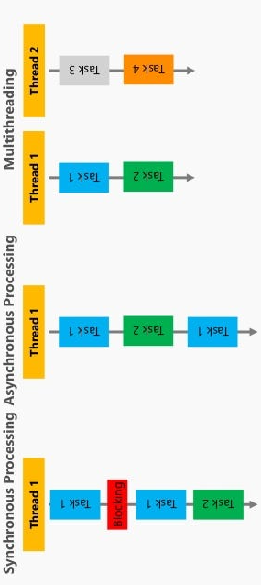
Asynchronous programming vs Multithreading.

Slide 11

Asynchronous Programming: Race Conditions.
Multiple tasks can modify a piece of data concurrently.
Operations can be executed in an out-of-order manner and this can be a problem if the order of execution affects the result.
Circular dependency: If one task depends on the other, they could wait indefinitely for the other task, causing a deadlock.

Slide 12
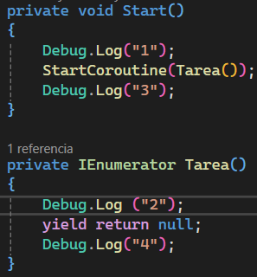
Coroutines
Asynchrony for exclusive use in Unity.
If the instance of the GameObject that starts it is destroyed, all associated coroutines are stopped.

Slide 13
Coroutines
Start the coroutine
Stores the state of the execution
Give back control

Slide 14
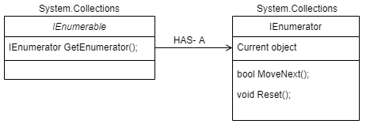
IEnumerator
C#: It is an interface that defines how a collection or sequence of elements can be traversed.
Unity Coroutines: Stores the state of the function execution, allowing controlled pauses and resumptions.

Slide 15
Yield
When a coroutine is started, it runs until it encounters a yield, at which point it returns control to the Unity system.
Unity interprets the value returned by yield to decide when to resume the coroutine.
At each execution cycle, Unity evaluates whether the conditions indicated by the yield have been met to continue the execution of the coroutine.

Slide 16
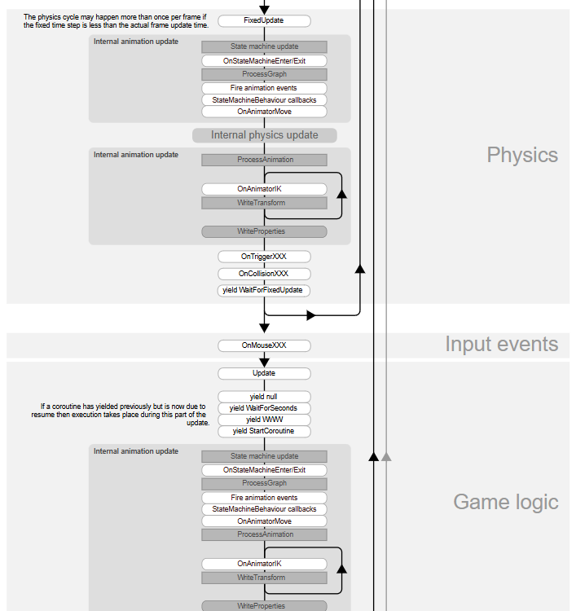
Yield

Slide 17
Coroutine: Usage Examples
yield return null; | Wait for one frame.
yield return new WaitForEndOfFrame(); | Wait until the end of the current frame.
yield return new WaitForSeconds(t); | Waits for a specified amount of time in seconds, affected by Time.timeScale.
yield return new WaitForSecondsRealtime(t) | Waits for a specified amount of time in real-time seconds, ignoring Time.timeScale.
yield return new WaitUntil(() => isReady); | Wait until a condition is true.
yield return new WaitWhile(() => isLoading); | Wait while a condition is true.

Slide 18
Coroutine: Usage Examples
yield return new WaitForFixedUpdate(); | Wait until the next FixedUpdate cycle, physics update.
yield break; | Ends a coroutine early.
yield return UnityWebRequest.Get(url) .SendWebRequest(); | Wait until a UnityWebRequest finishes.
yield return SceneManager.LoadSceneAsync | Wait for a scene to load asynchronously.
yield return Resources.LoadAsync("AssetPath"); | Waits for a resource to load asynchronously.
yield return new MyCustomYieldInstruction(); | Wait until a custom condition is met.

Slide 19
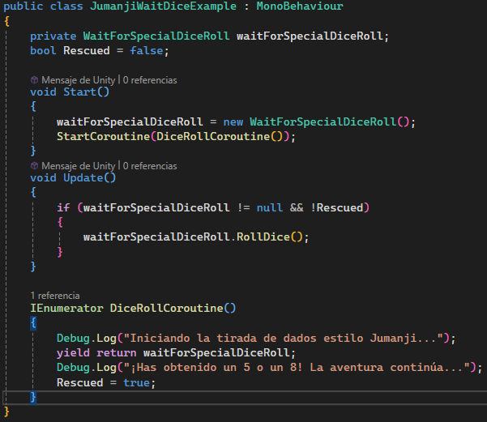
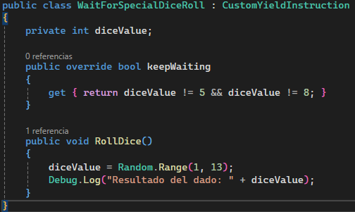
CustomYieldInstruction

Slide 20
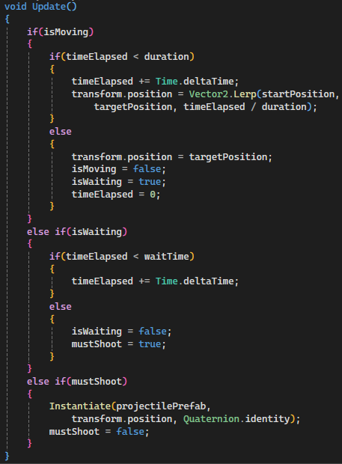
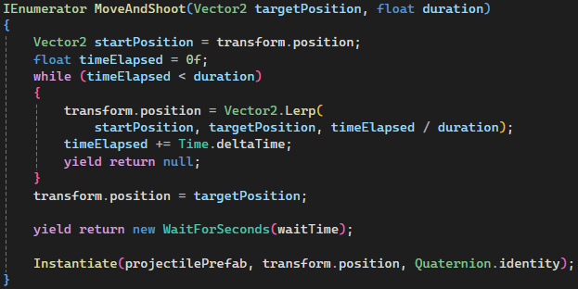
Coroutines vs Update

Slide 21
Corrutinas vs Update
With Update the code becomes more complicated with more checks.
In a sequence you must check which step you are in at each moment.
When the sequence ends, the update continues doing the checks.

Slide 22
Async
It was introduced in Unity starting with version 2017.1, when Unity updated its runtime to support C# 6.0 and .NET 4.x versions.
If the instance of the GameObject that initiates it is destroyed, the Async continues.

Slide 23
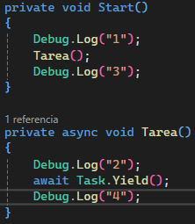
Async
Calling asynchronous function
We must declare the function as asynchronous
Non-blocking wait for the task to finish
Represents an asynchronous operation.
Suspends the task until the next execution cycle

Slide 24
Async: Usage Examples
await Task.Yield() | Suspends the task until the next execution cycle.
await Task.Delay(milliseconds) | Suspends the task for the specified number of milliseconds.
await Task.WhenAll(tasks) | Wait until all tasks in the specified collection are completed.
await Task.WhenAny(tasks) | Wait until any of the tasks in the collection are completed.

Slide 25
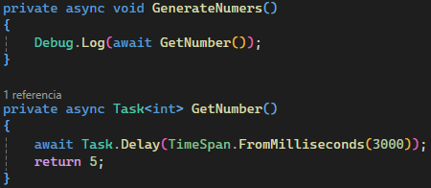
Async : Returning a value.

Slide 26
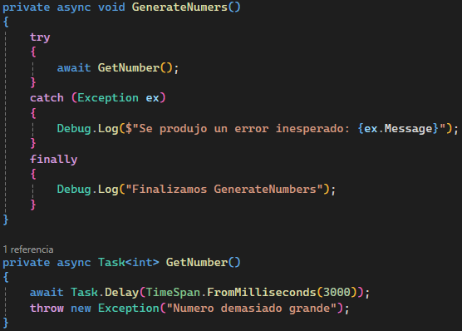
Async: Exception handling.

Slide 27
Async: Status. Task Status.
Created | The task was created, but has not started yet.
WaitingForActivation | The task is waiting to be activated.
WaitingToRun | The task is ready to run, but has not started.
Running | The task is actively running.
WaitingForChildrenToComplete | The task waits for child tasks to complete.
RanToCompletion | The task completed successfully.
Canceled | The task was cancelled using a CancellationToken.
Faulted | The task threw an exception and did not complete successfully.

Slide 28
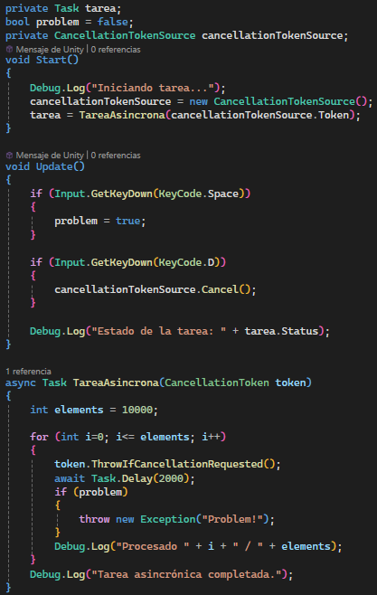
Async: State

Slide 29
In previous Episodes…

Slide 30
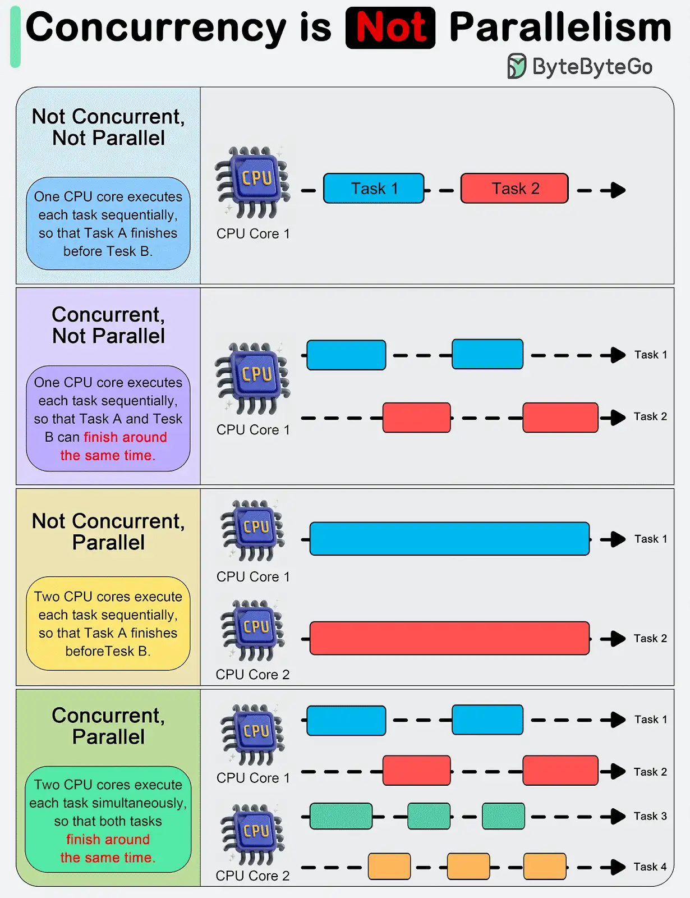
Asynchronous vs Multithreading

Slide 31
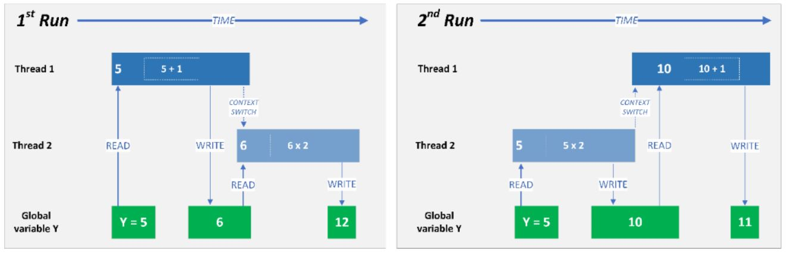
Race Conditions - I

Slide 32
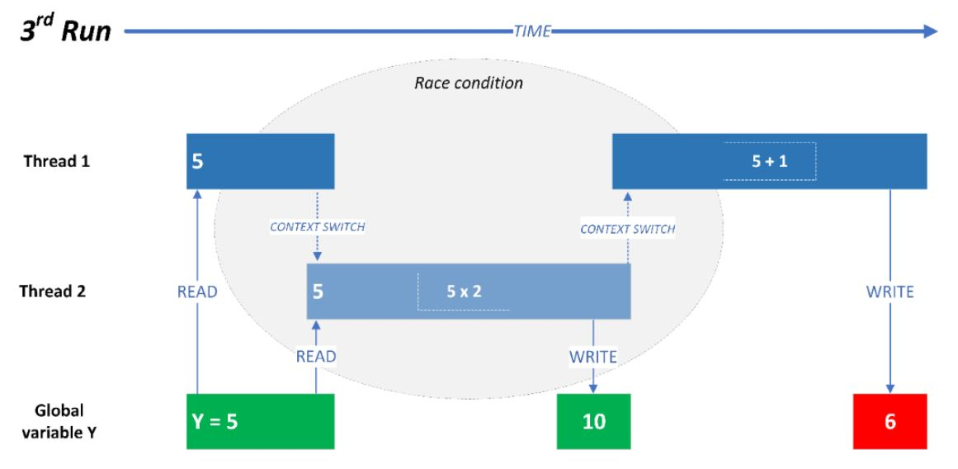
Race Conditions - II

Slide 33
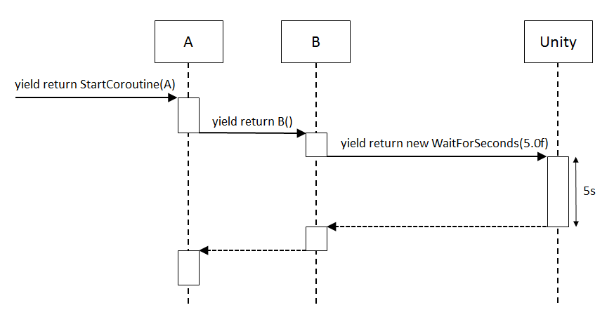
Coroutines - I

Slide 34

Coroutines - II
Key words:
IEnumerator
Yield
Pros:
Included in Unity’s lifecycle
Dies when object dies
Cons:
Can’t return value
Dies when object dies

Slide 35
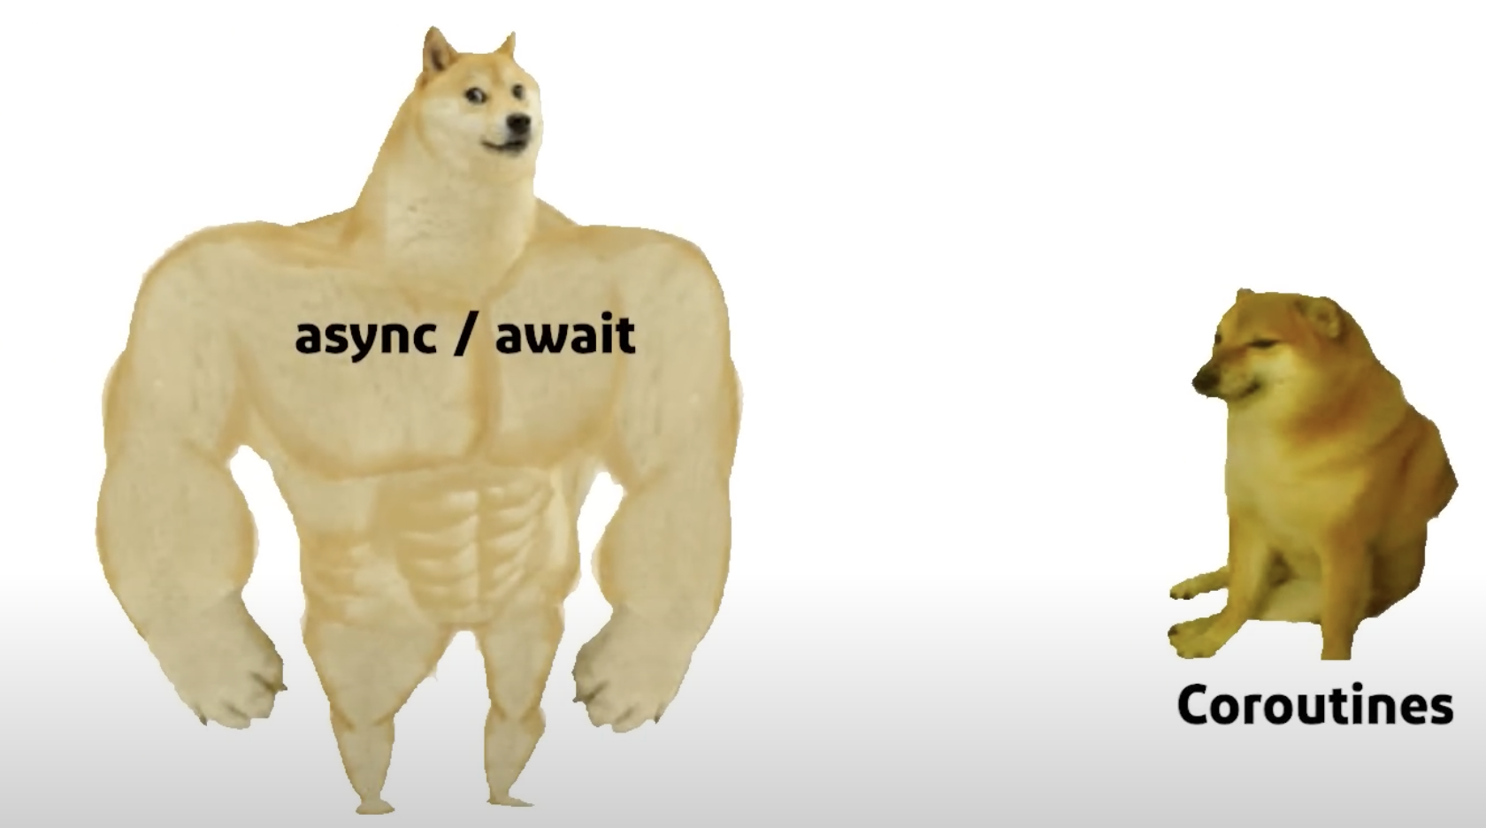
Await/Async
Key words:
await
async
Task
CancellationToken
Pros:
Not Included in Unity’s lifecycle
Do not dies when object dies
Status to know the state of the process
Can return values
Cons:
Do not dies when object dies
Harder to cancel
More expensive for the Garbage Collector

Slide 36
Coroutine vs Async : Performance
The execution time of yield and await is practically the same.
A coroutine takes up more memory than an Async.
With Async the garbage collector consumes more memory.
With Async, much more garbage is allocated per operation.
Async consumes more system resources.

Slide 37
Coroutine vs Async : Usability
The coroutine can only be used in Mono Behaviours classes.
Async is compatible with any class.
Async supports Scriptable Objects.

Slide 38
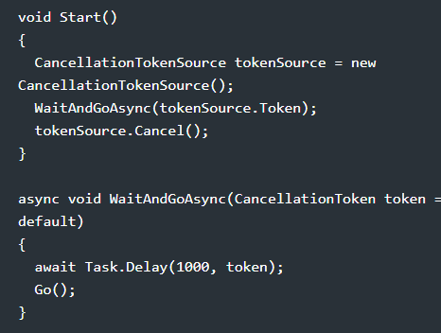
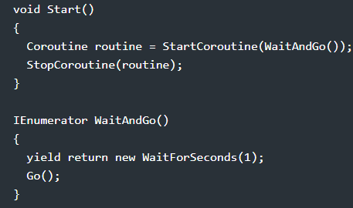
Coroutine vs Async : Usability
Coroutines are easier to stop.

Slide 39
Corrutina vs Async : Usability - Waitability.
Async can await any asynchronous method.
Coroutines have many custom yield statements synchronized with Unity's time.
Coroutines are ready to work with Unity's Async Operations.

Slide 40
Corrutina vs Async : Usability
Async can have multiple wait conditions. Task.WhenAny or Task.WhenAll.
Async allows values ​​to be returned upon completion of the operation.
To return a value with coroutines we must rely on a callback.

Slide 41
Coroutine vs Async: Control - State
Async: The Task object has several ways to obtain its state, making it much easier to manage.
Coroutines have absolutely no information about whether the process has finished or what is happening to it.

Slide 42
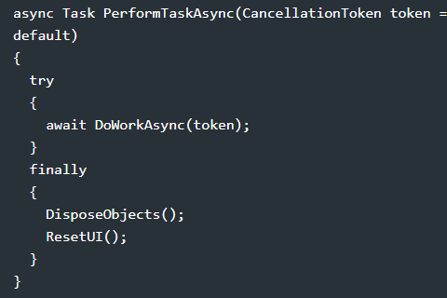
Coroutine vs Async : Control - Finalization.
Once coroutines finish executing, no code will be executed.
In Async the finally block will always be executed.

Slide 43
Aspecto | Corrutina | Async
Performance | Ocupa más memoria que Async. | It takes up more memory than Async.
Performance |  | Allocates much more garbage per operation.
Performance |  | It consumes more system resources.
Usability | Can only be used in MonoBehaviour classes | Compatible with any class and OS.
Usability | Easier to stop.
Waitability | It has many custom yield statements synchronized to Unity. | You can await any async method.
Waitability | Ready to work with Unity's AsyncOperation.
Waitability |  | Supports multiple wait conditions with Task.WhenAny or Task.WhenAll.
Return values | Needs a callback. | Upon completion of the operation.
Control - State | Does not provide information. | Task allows you to get its status
Control - Finalization |  | The finally block is always executed

Slide 44
UniTask - THE WAY TO GO
https://github.com/Cysharp/UniTask
This extraordinary package is fully integrated with Unity.
It has support for AsyncOperations, MonoBehaviour/uGUI and the Unity update cycle.

Slide 45
UniTask
It has the flexibility and control of Async.
It also adds the benefits of coroutines.
It is lighter and gives us a performance boost.
Performance Study: Coroutines, Async and UniTask.

Slide 46
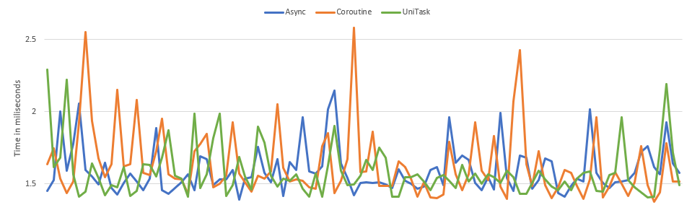
UniTask. Performance
Time to Yield

Slide 47
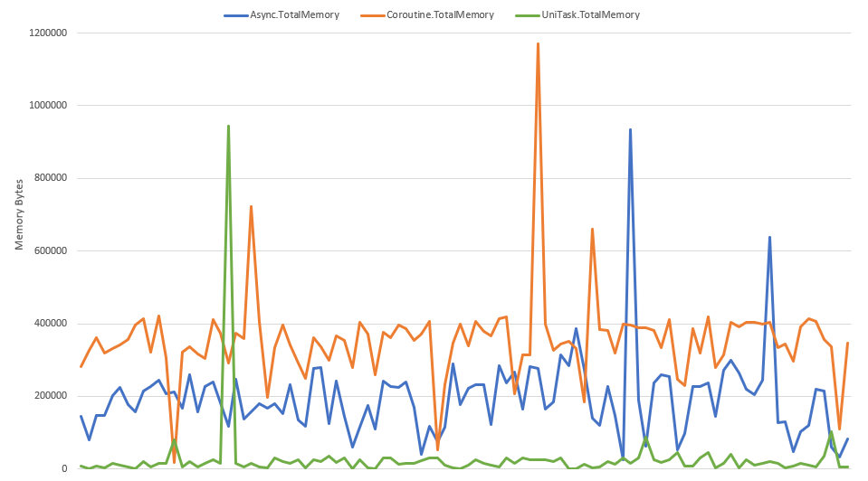
UniTask: Performance
Full memory load.

Slide 48
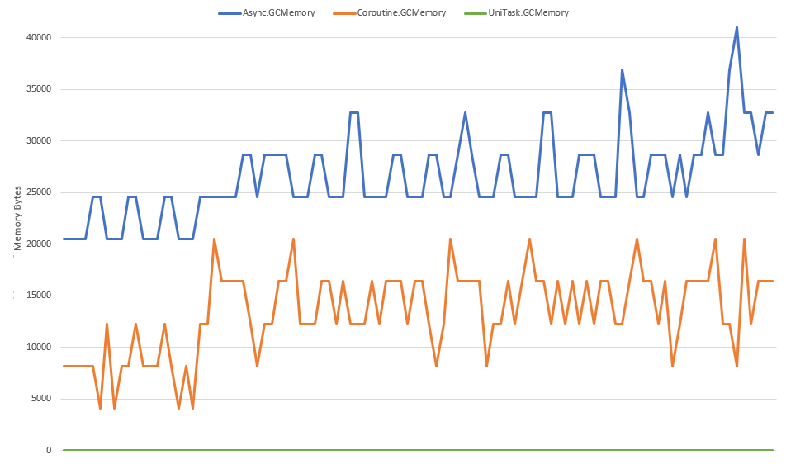
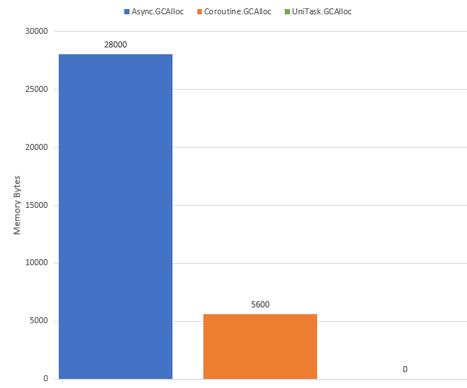
UniTask: Performance
Memoria del recolector de basura.

Slide 49
Practical use: Web Request
Download an image from a CDN/Server and put that image into a UI Image sprite.

Slide 50
Practical use: Spaceship sequence
Make the ship move into a position and fire a burst of bullets.

